Slide 1



HR Attrition Analysis
View in Power BI
Last data refresh:
22/04/2025 14:04:52 UTC
Downloaded at:
22/04/2025 14:07:00 UTC

Slide 2
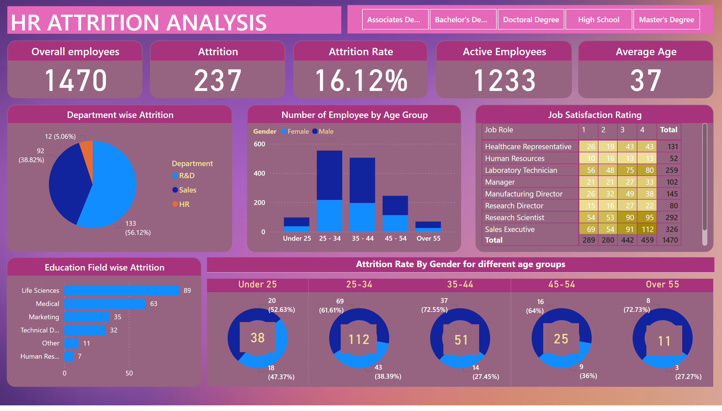
Page 1
Notes:
Overall employees
No alt text provided
Attrition
No alt text provided
Attrition Rate
No alt text provided
Active Employees
No alt text provided
Average Age
No alt text provided
Department wise Attrition
No alt text provided
Number of Employee by Age Group
No alt text provided
Job Satisfaction Rating
No alt text provided
Education Field wise Attrition
No alt text provided
Under 25
No alt text provided
Attrition Rate By Gender for different age groups
No alt text provided
25-34
No alt text provided
35-44
No alt text provided
45-54
No alt text provided
Over 55
No alt text provided
card
No alt text provided
card
No alt text provided
card
No alt text provided
card
No alt text provided
card
No alt text provided
HR ATTRITION ANALYSIS
No alt text provided
slicer
No alt text provided

